Slide 1
Greg Focaccio
Code #
IT Specialist
Month Day, 2025
1

Slide 2


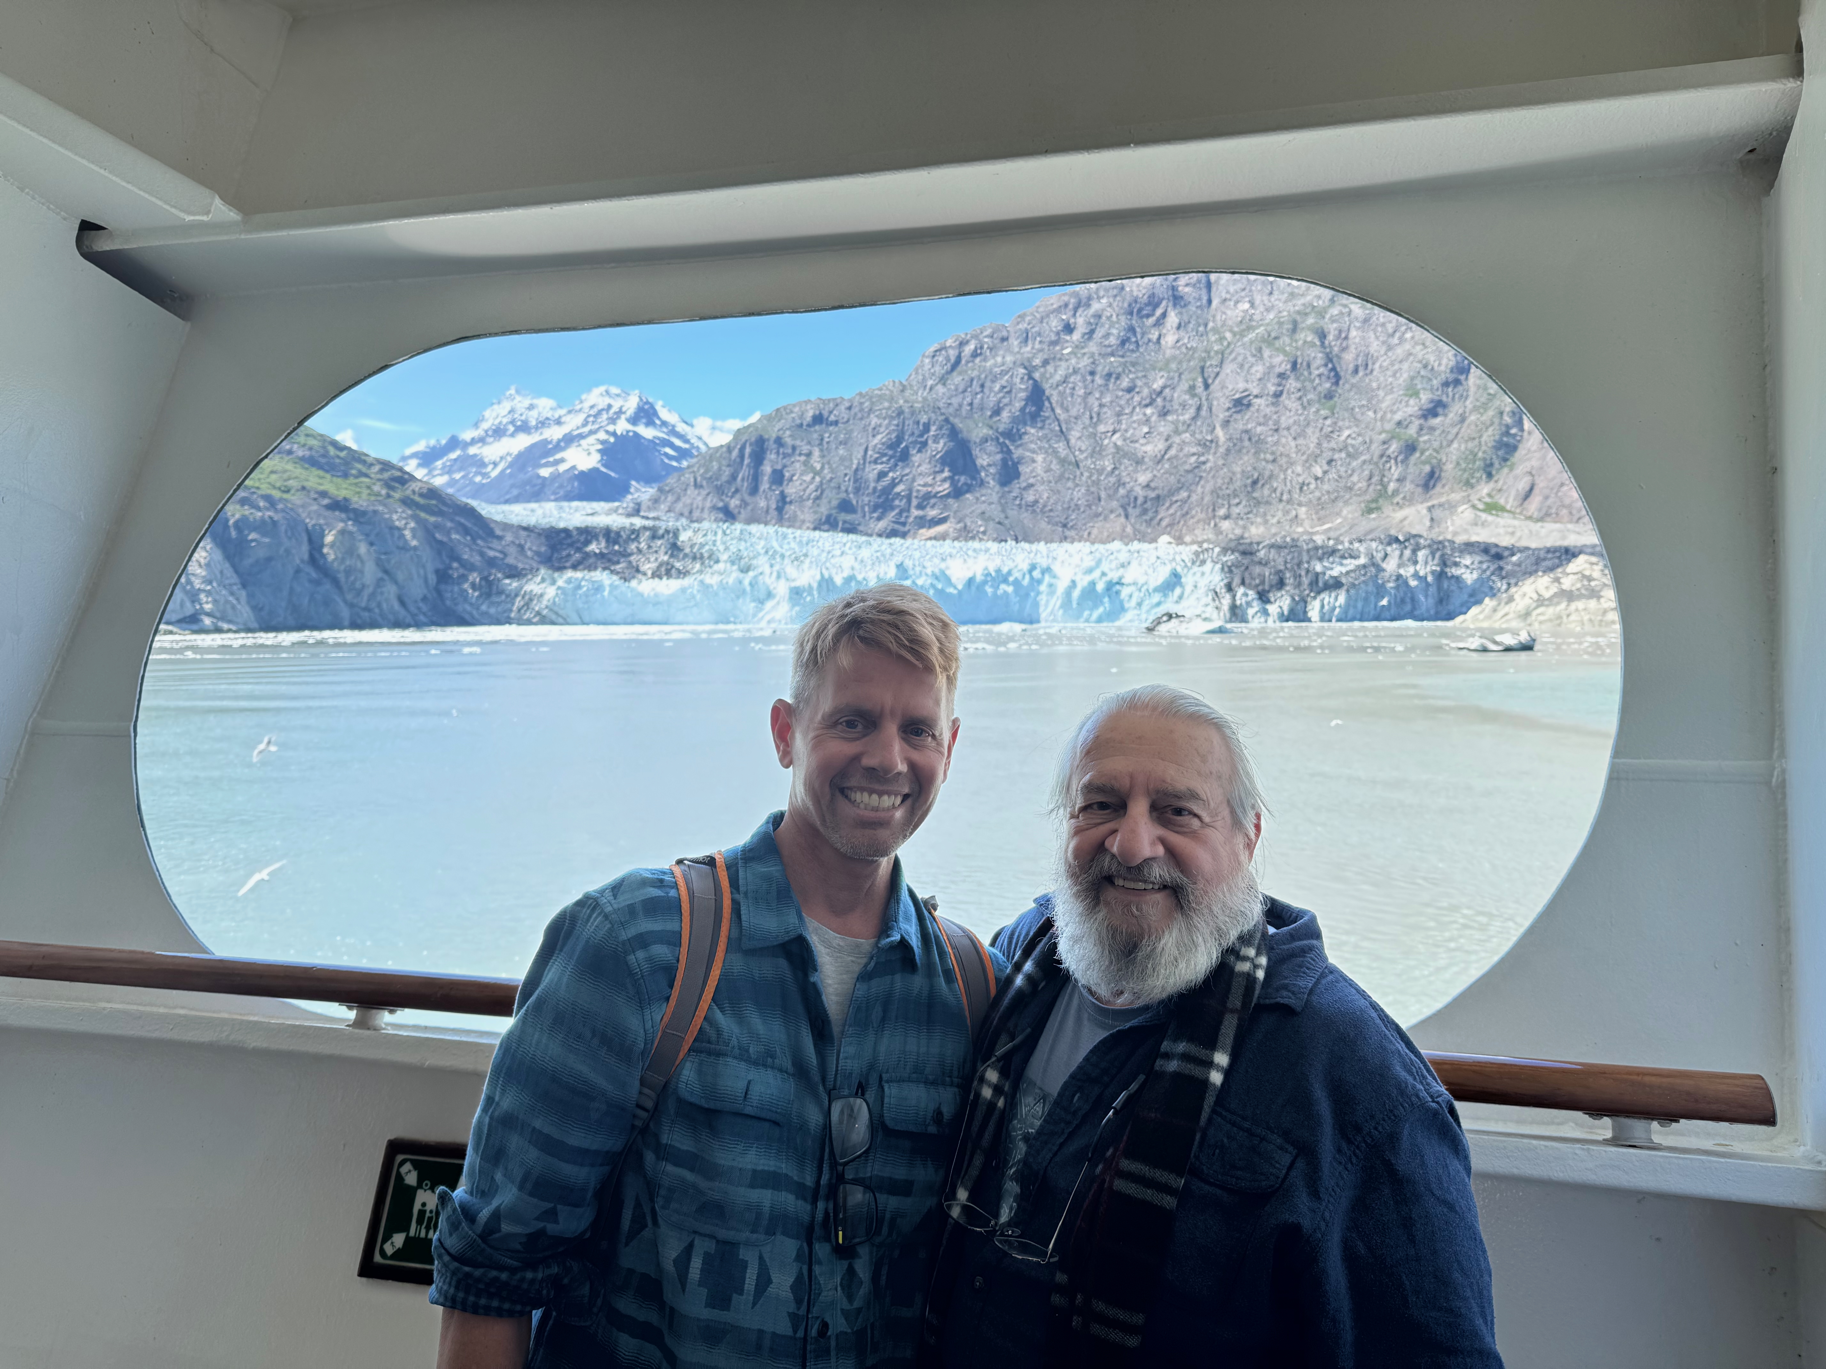
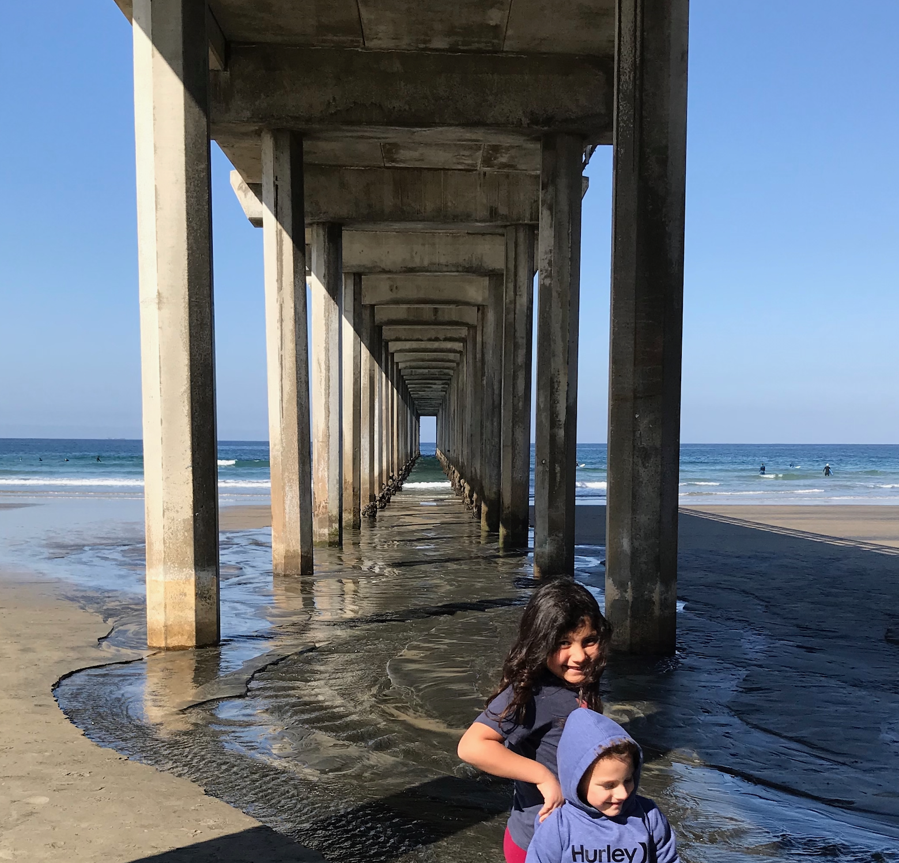
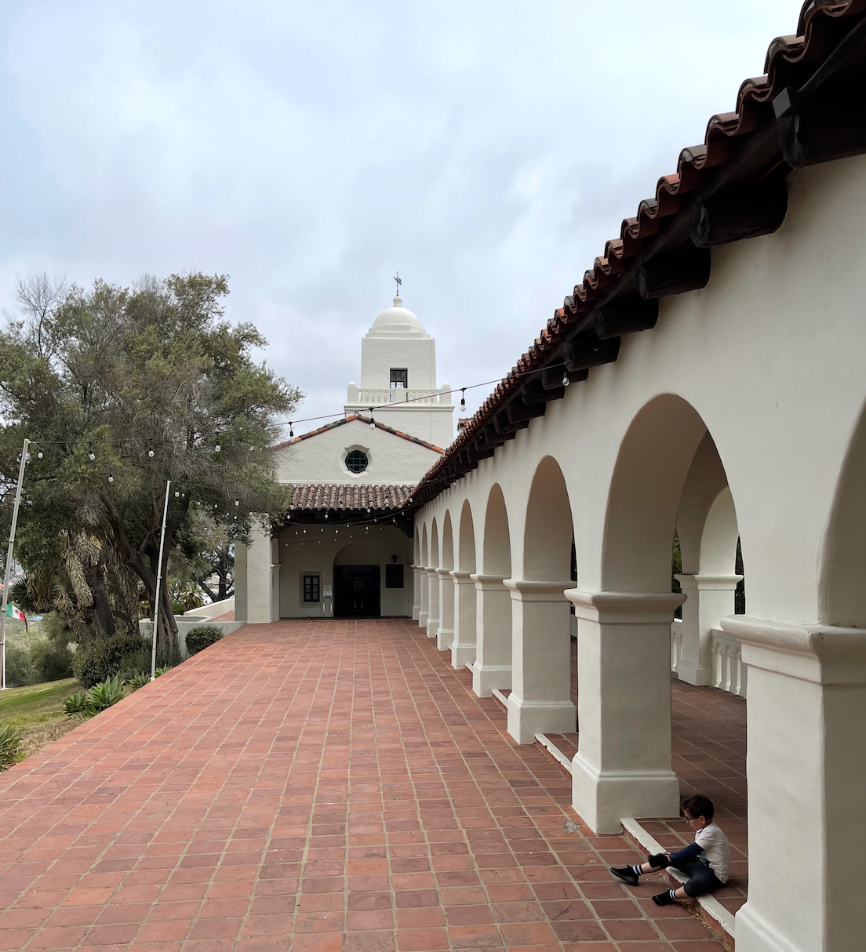

Personal
2

Slide 3
Personal
Personal
Native San Diegan
Home in Tierrasanta
Married for 16 years
Three children at home
Daughter 12, Son 9 , Daughter 4
Three grown step-children
Out of the home with 4 grandkids
One Step-Daughter is a Senior Airman Rank [X] in Airforce at Beal AFB married to an Airman
One Step-Daughter is married to an Army Sergeant soon to be stationed at Fort Irwin near Barstow
Interests / Pets / Fun Facts
Garage Network Lab
Enjoy building test Networks at home
Gardening - Enjoy growing Native Plants and Cacti
Activities - Camping, Hiking, Bodysurfing, Tennis
Pets - Desert Tortoise, Small Poodle
Fun Facts
Born the day of the Apollo 11 Moon launch
Visited Egypt King’s Chamber of Great Pyramid
Marathon Finisher - SD Rock N’ Roll 2007, 2010
Summited San Jacinto 10,834 ft Palm Springs
Goal to Summit Mt. Whitney
First computer - IBM PC with two floppy drives
Basic, Fortran, Pascal in High School
Drove Baja California - Cabo San Lucas 2008
3

Slide 4

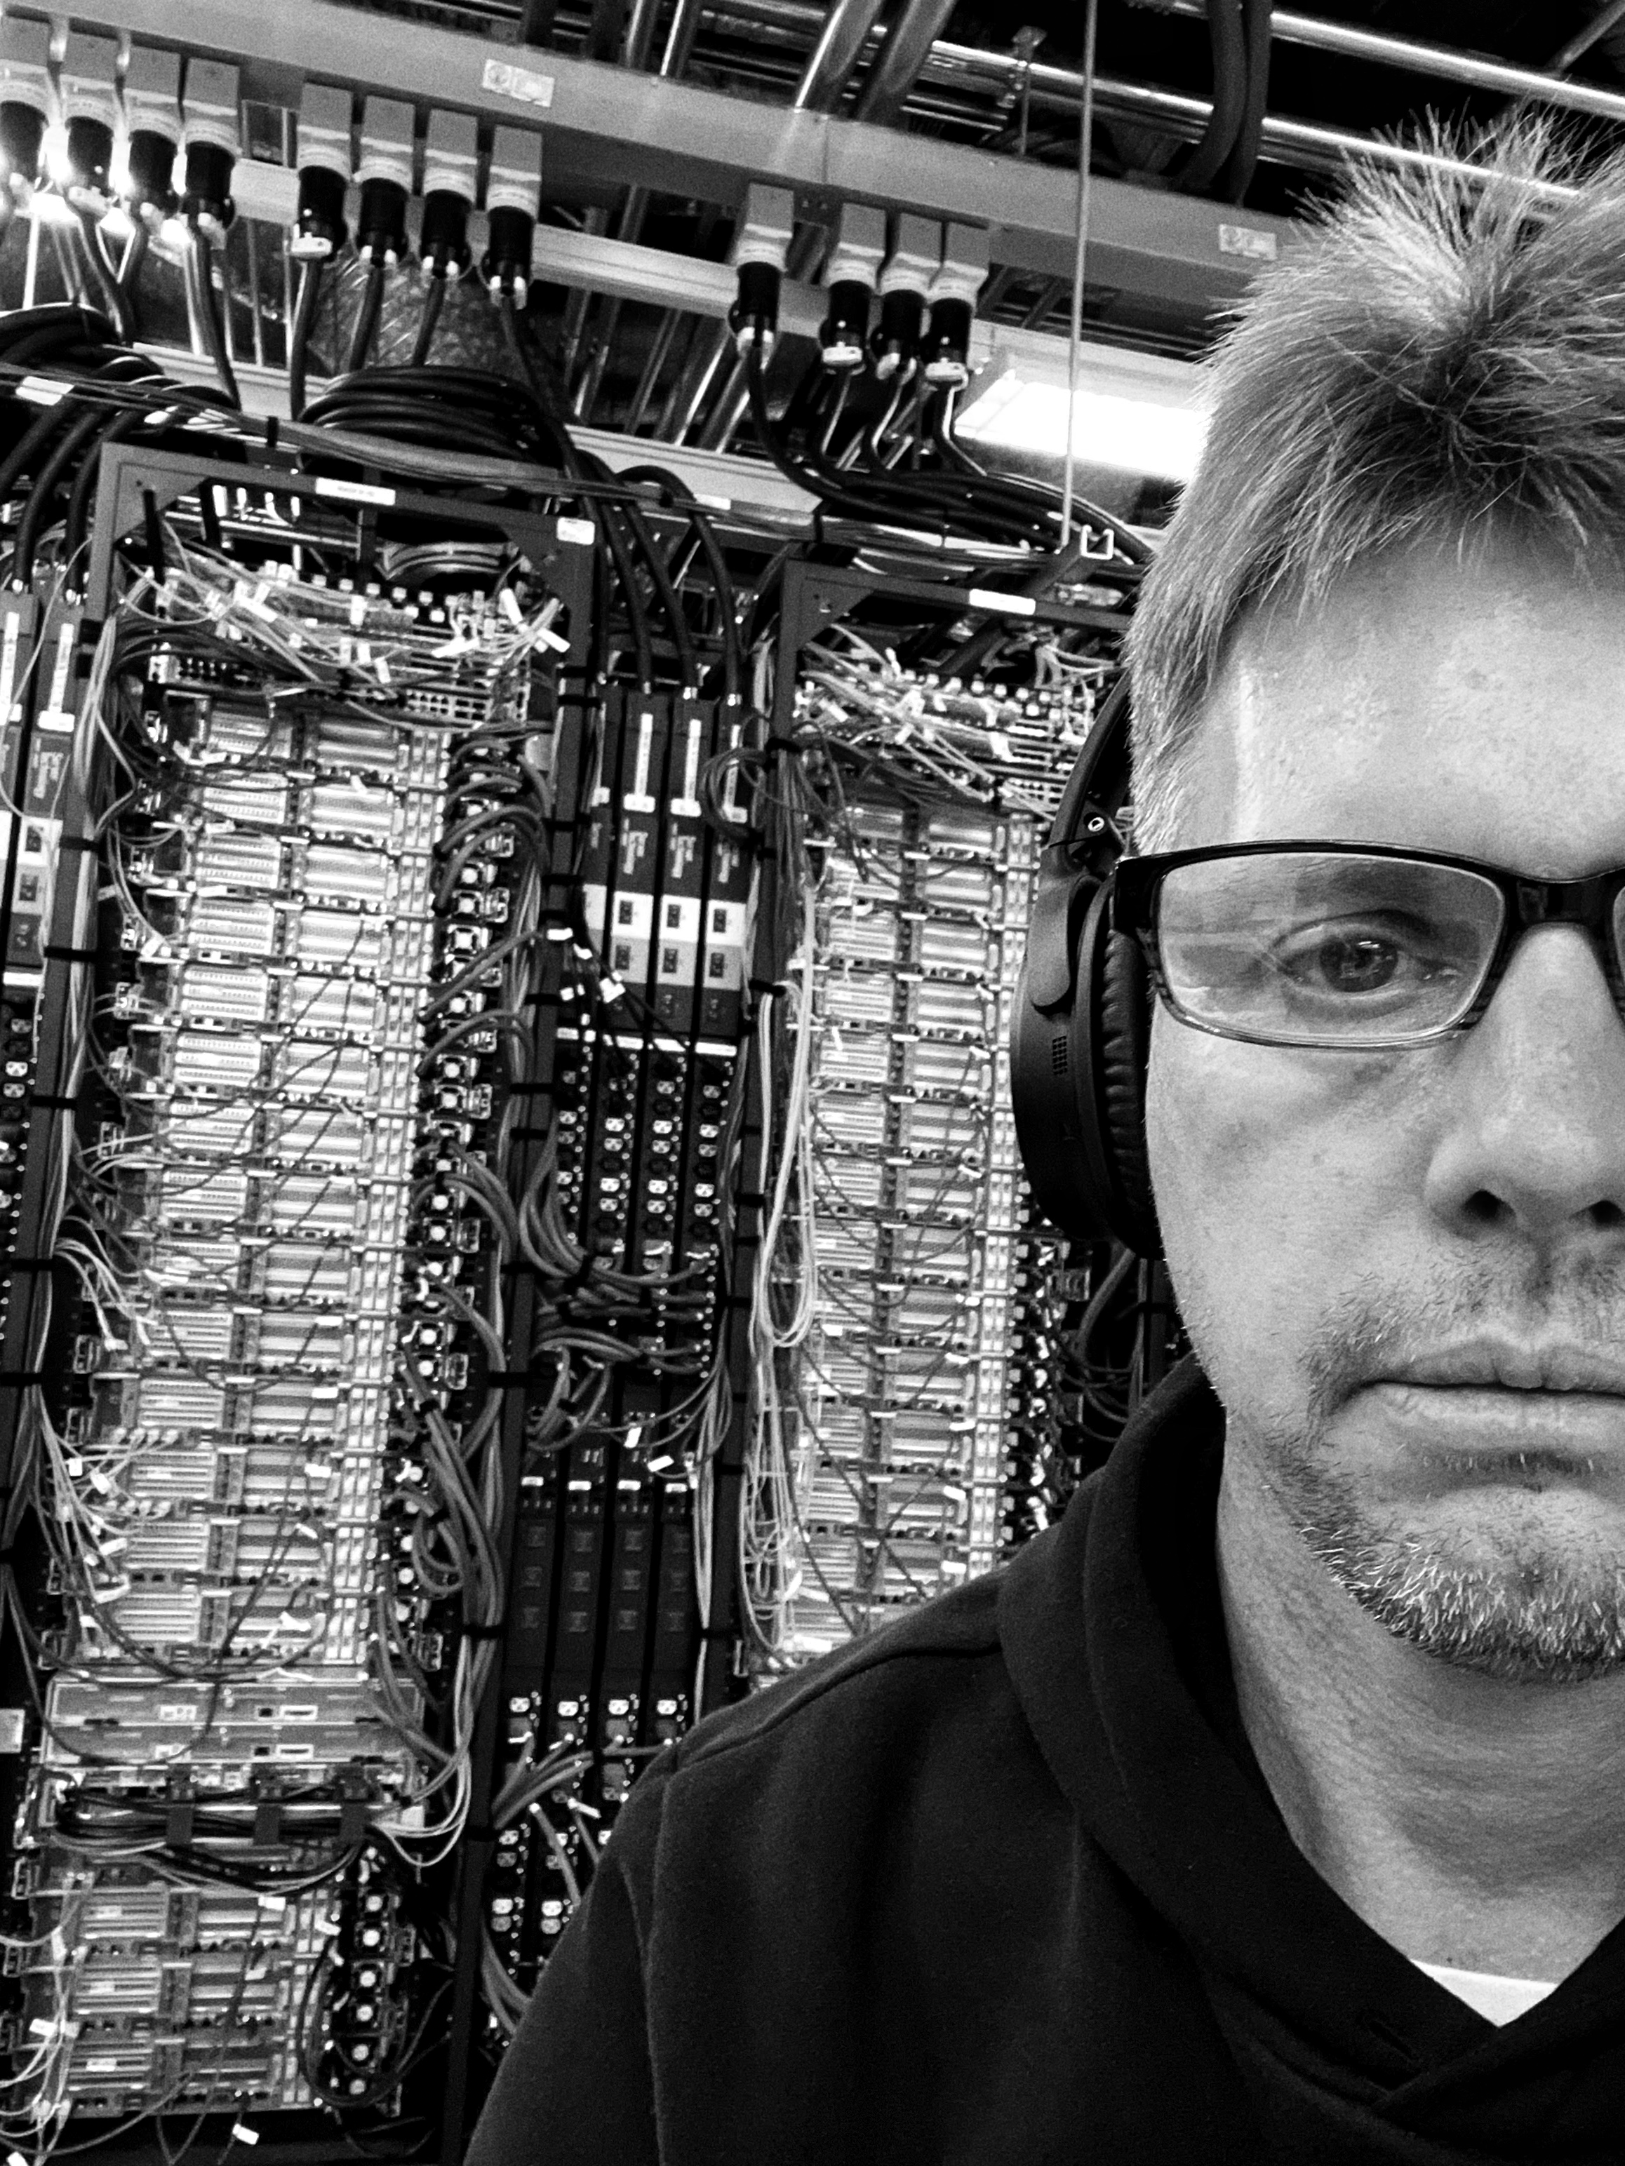
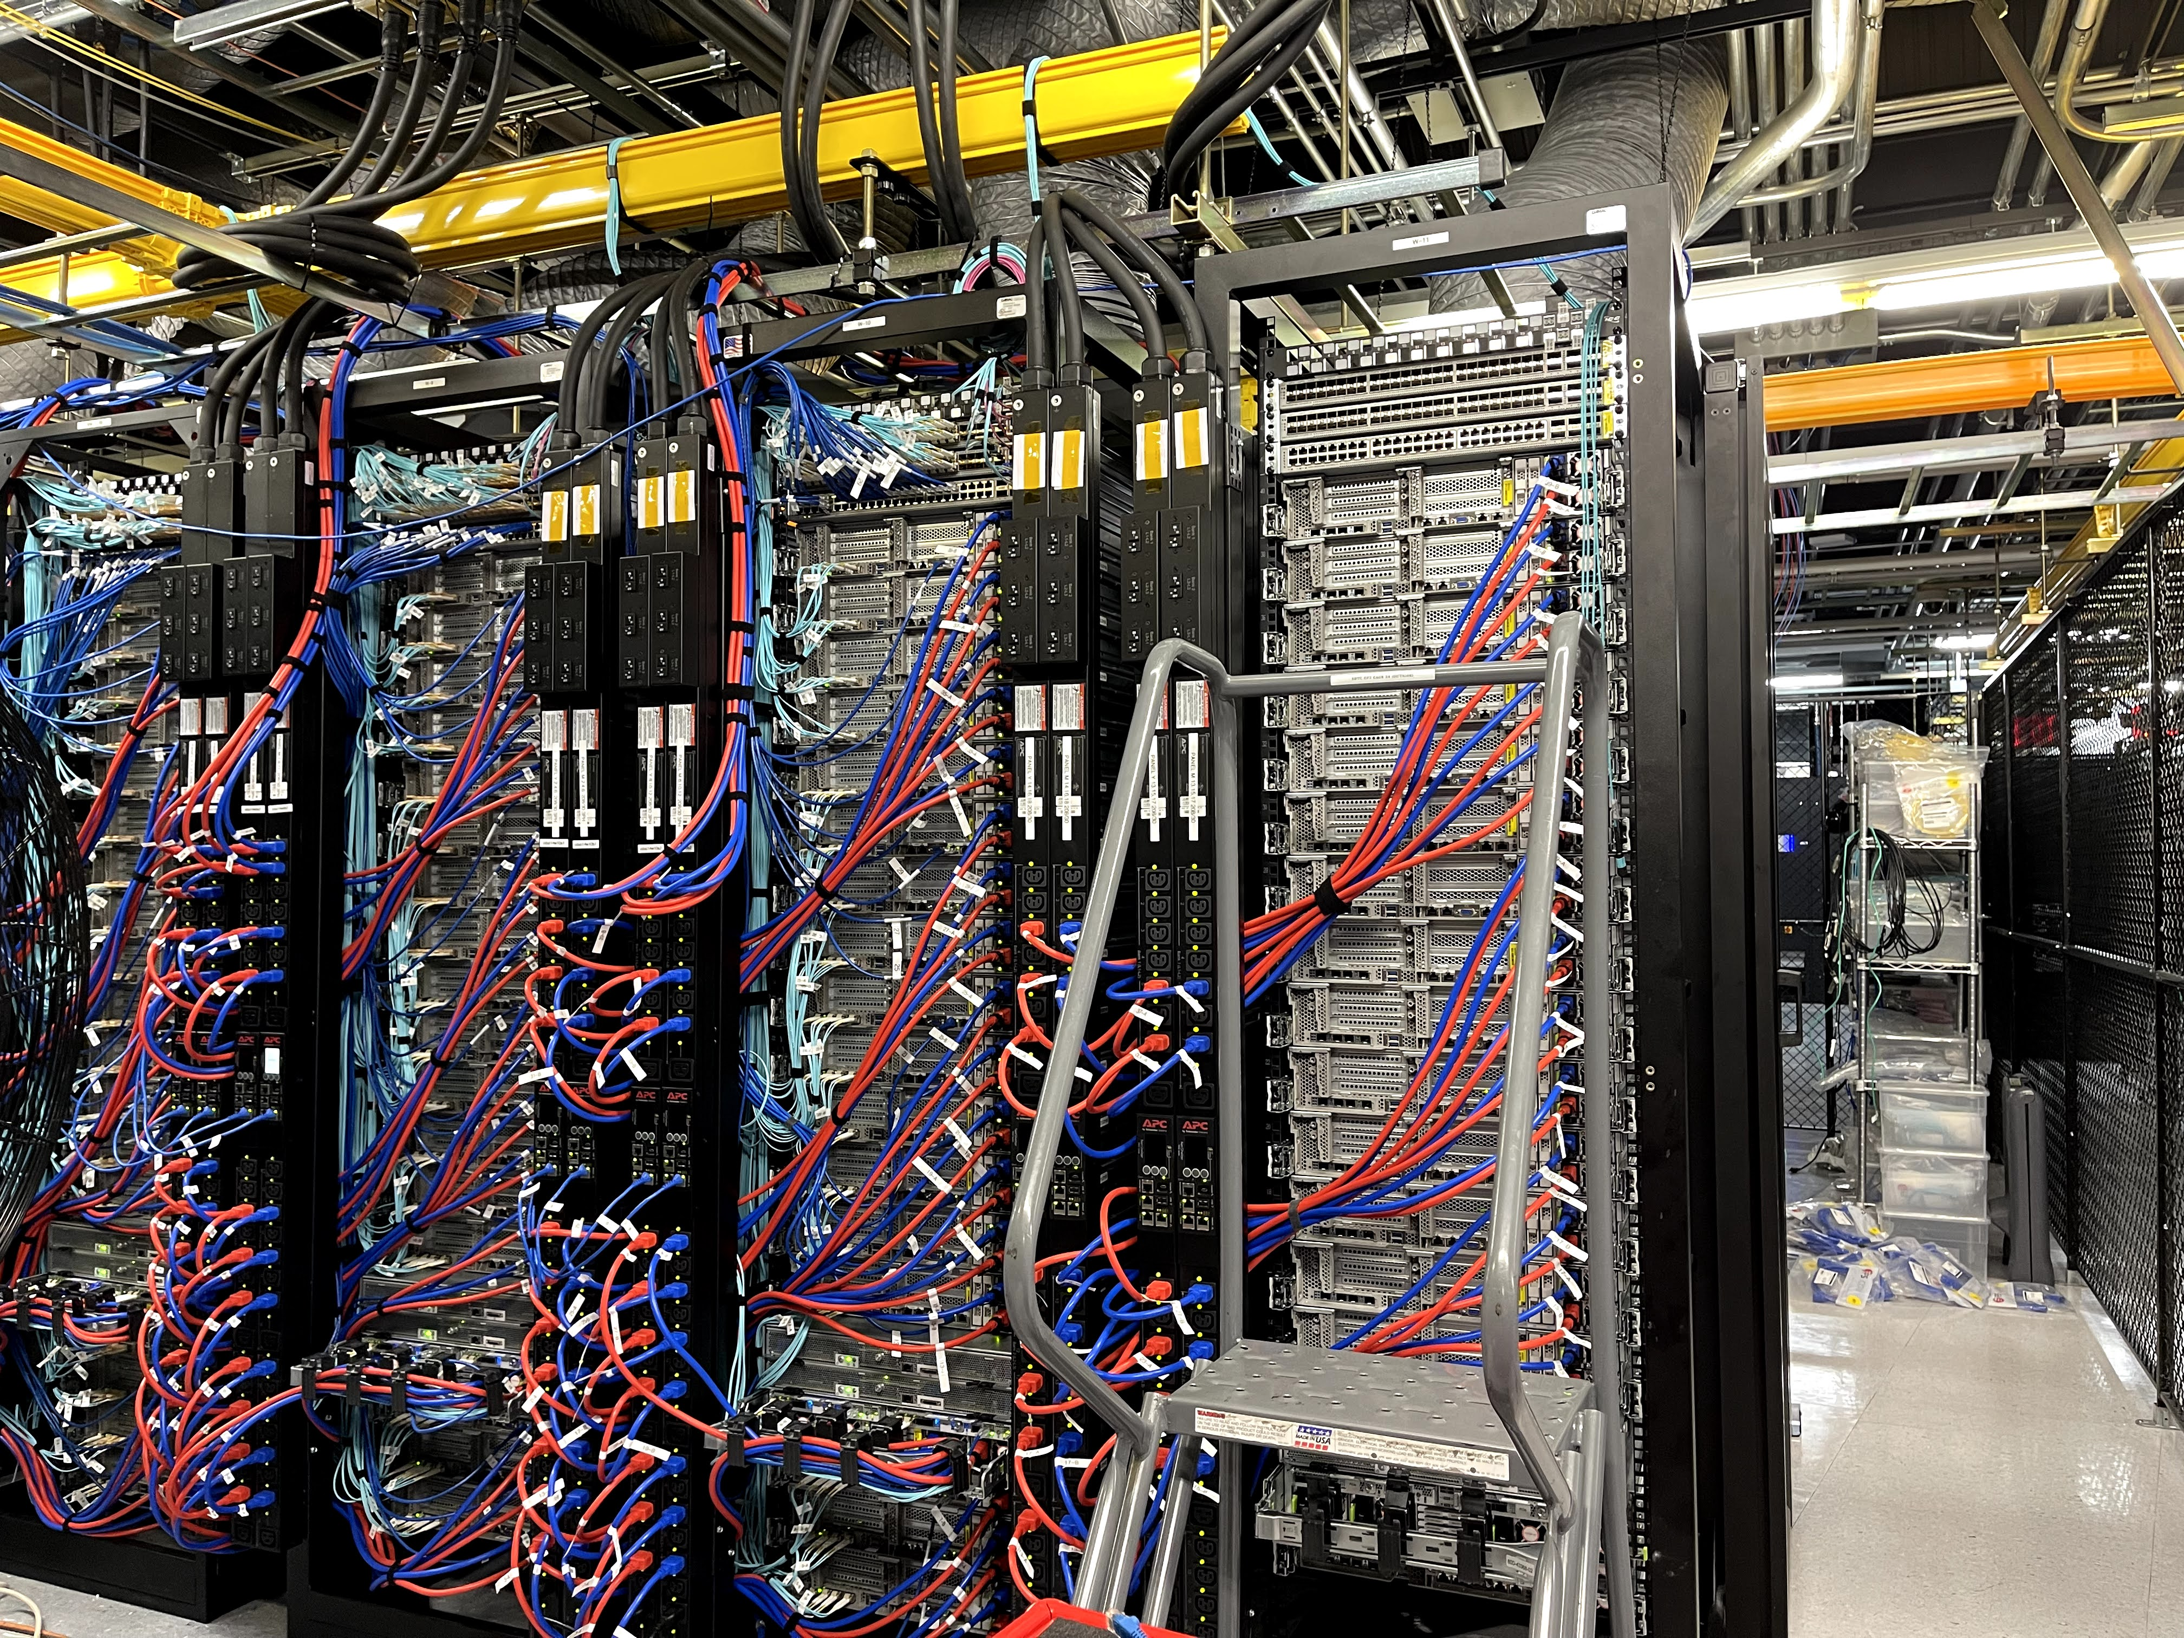
Work
4

Slide 5
Work
Education
Pomona College, Cum Laude, 1991
Work Experience 15 Years
Full Spectrum of Network Engineering
* Design and Engineering
* Infrastructure Implementation
* Operations and Troubleshooting
Principal Engineer Datacenter, ISP (M5 Hosting) 2021
SIPR Transport Engineer DoD Contractor 2018-2020
Principal Engineer Datacenter, ISP (CARI.net)
Senior Engineer ISP / VoIP (NextLevel Internet)
Partner Engineer Network Consulting (GoNet Forward)
Junior Engineer Network Services (Network Insight)
Certifications
CCNP Cisco Certified Network Professional (Past)
Security+ (Current)
NIWC PAC
Joined 4 years ago as Contractor
Civilian Navy 2 years in 2023
Working in Branch X on Project X
Role: IT Specialist (Network Lead) / Deputy IPT
Develop and Refine Network Roadmap
Support wider view and longer-term objectives coming from NAVWAR and Program Office
Provide novel capabilities and ideas to NAVWAR and PO via Team IPT and LE
Network RDTE - Create Engineered and Tested Solutions, Capabilities, and Integrations
Network Implementations - Support Fleet and Lab Build-Outs, Modernizations, and Integrations
Network Operations– Back-stop for Fleet Operations, Incident Management (CASREPs), and Troubleshooting
5

Slide 6
Project Highlights
Fleet
Engineered key cybersecurity improvement, satisfying major FCC Program requirement
Delivered key cybersecurity requirement to Fleet enabling Major Milestone (cutover) for Project
System accepted on DATE as modernized replacement for past system within X
Supported initial site implementation of Cybersecurity improvements
Delivered First Network Visibility Capability to System
Supported key external System Assessments
Provided key network engineering required to enable high profile international cooperative functional demonstration of new undersea communication modality
SCITF (Pac X Lab)
Modernized Management of Lab Network
Added New Lab Capabilities
New wide area network (WAN) simulator
Tools and network modeling software
Enabled International Network Link to UK for key capability functional demonstration
9

Slide 7
FY 26-28
Fleet
New Network Architecture, Hardware Modernization, New Services
IP addressing, WAN architecture, New virtualized environments
Mature monitoring and management services
Mature Cybersecurity hardening
Identity and Access Management, Zero Trust Architectures
Introduction of Automation
Infrastructure as code
Maintain and grow key integrations and new capabilities
Lab
Maintain and improve lab conformance as Fleet representative engineering and test environment
Develop new approaches to configuration automation and testing automation
Support more system of systems lab integrations to enable more complete E2E testing
10

Slide 8
Greg Focaccio - NIWC PAC - Career, Future
Next 2-3 Years
Continue as technical contributor on project during key modernizations
Learn about and promote openness to working as technical contributor on other high profile network heavy projects
Begin to develop Team leadership experience and training
Open to Initial roles as Technical team lead (IPT)
4 Years out and beyond from present:
Gain experience as Technical team lead
Further out
Mentor as Technical Lead to Junior Technical leads
11

Slide 9
What Differentiates me that is of value to NIWC PAC
Perspective and Gratitude
Appreciation for the History, Prestige and Mission criticality of the Center
Grateful to be able to contribute to a Mission as an inherent motivation, versus commercial
Career Arc Position and Continuity
Latter in my Career Arc, hope and expect to remain with NIWC and NAVWAR
Continuity provides value, in maintaining state and supporting informed decision making
Qualities
Accept and Enjoy Difficult Challenges – Especially Network Centric
Enjoy working on the edge – Pushing technologies and breaking new ground
Natural Sincerity and Team Orientation
Background rooted in Science - Strong orientation for detail and testing
Imagination - Enjoy conceptualizing new ways of doing things
18

